Slide 1

University system
Yousef Saber Abdelkarim

Slide 2


Agenda
introduction
Database design
SQL implementation
PLSQL
Automation script
Java application
Reporting

Slide 3


Introduction
This detailed guide provides a thorough overview of a University System, including its design, execution, and features. It encompasses database structuring, SQL incorporation, PL/SQL procedures, an automated script, and a Java program. Each segment is intricately explained to ensure a comprehensive grasp of the system's framework, aiding in its smooth development, upkeep, and issue resolution.

Slide 4
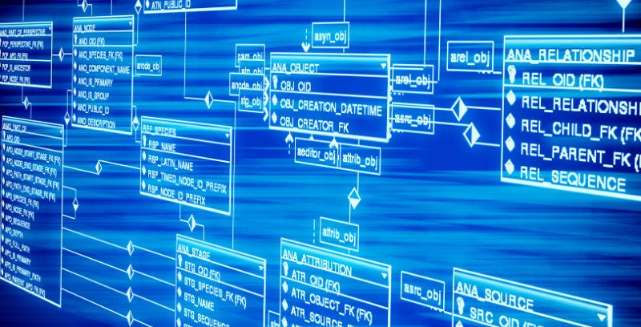


Database design
Subtitle

Slide 5
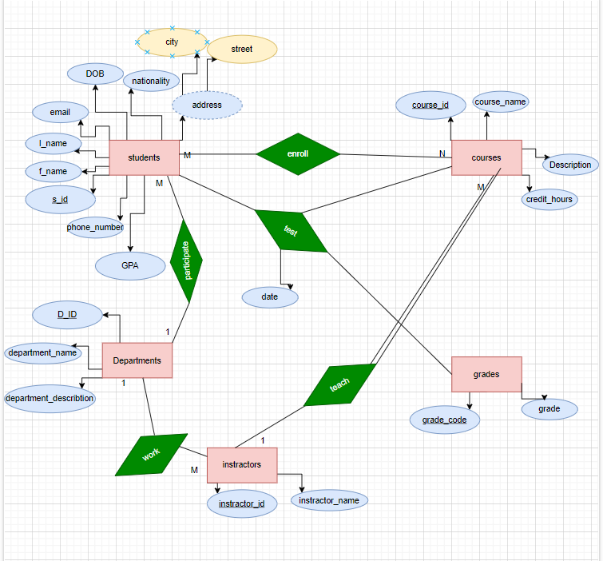
Erd
The ERD offers a detailed insight into the relational database schema designed to manage student, instructors ,course, department, and grade data efficiently.

Slide 6
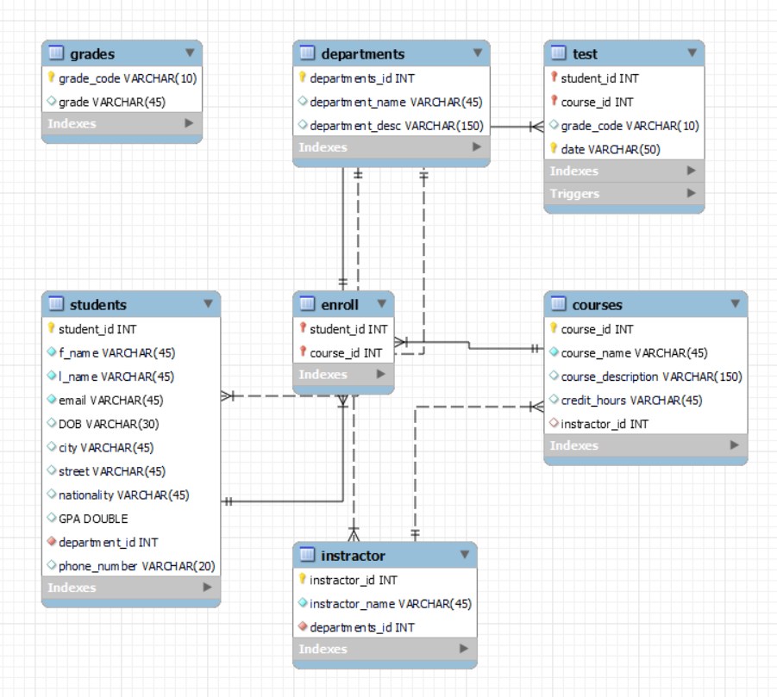
SQL implementation
Design Logical Map

Slide 7
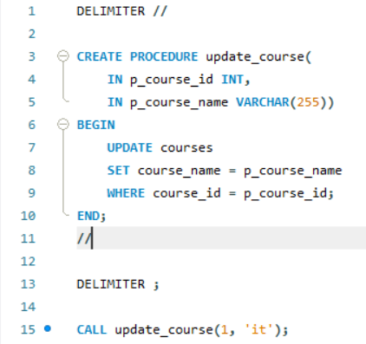
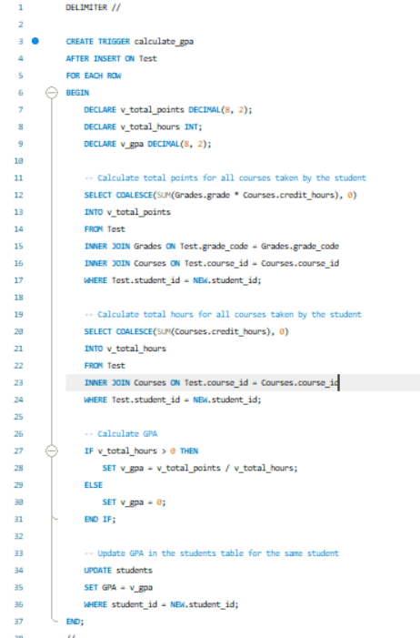
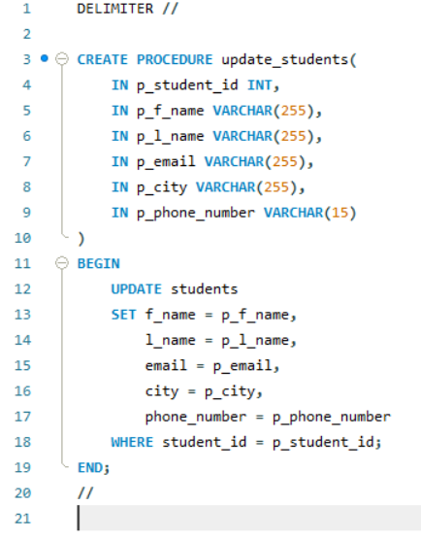
PLSQL
Procedure 1 : to update students
Trigger
To calculate GPA for student
Procedure 2 : to update courses

Slide 8
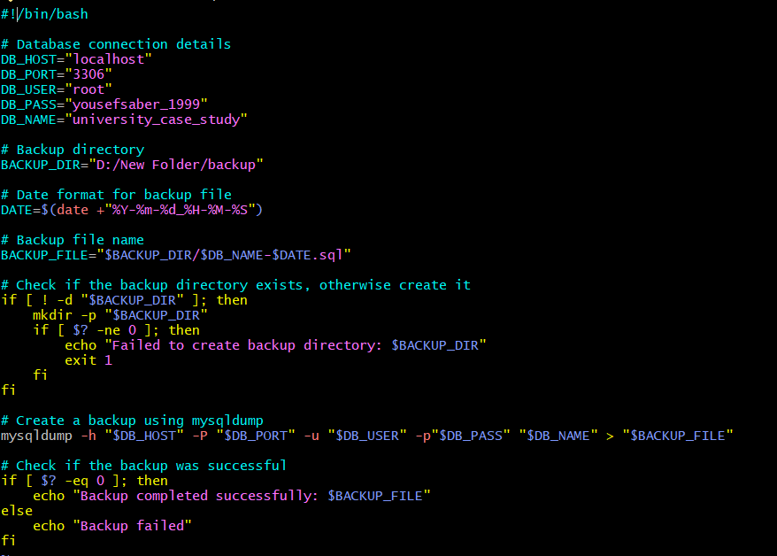
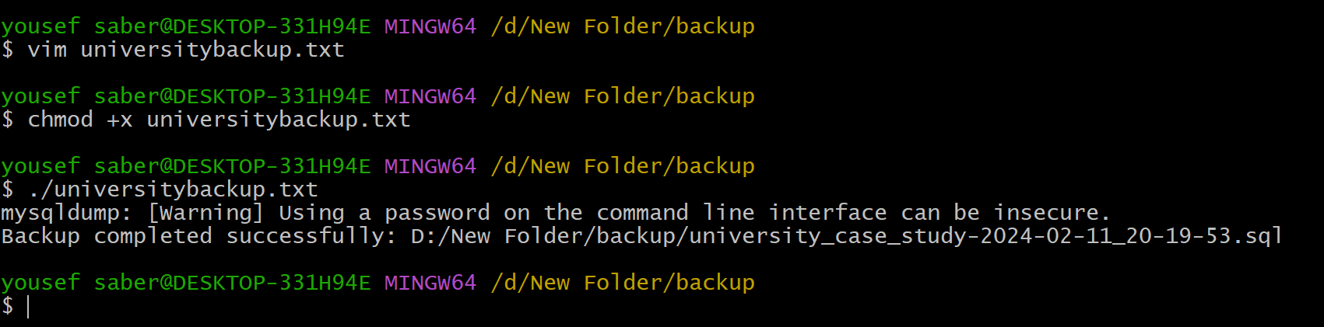
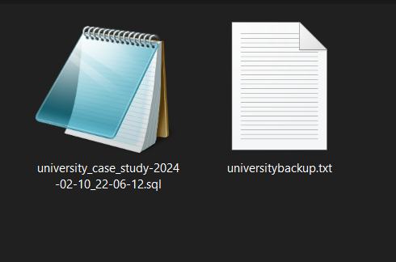
Automation script
Task 1: backup
Task 1: backup
Task 3
anomines
Task 2:Disc monitor

Slide 9
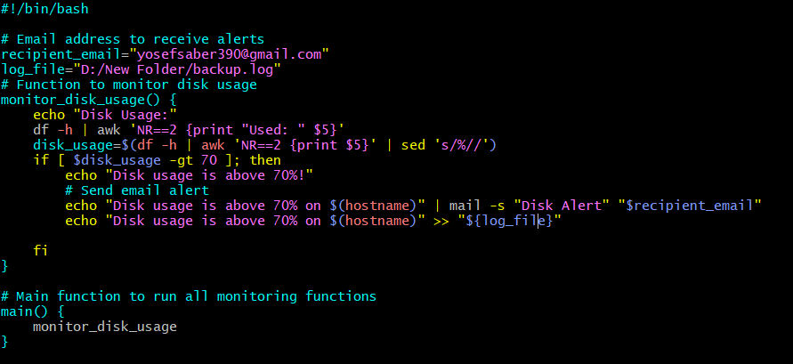
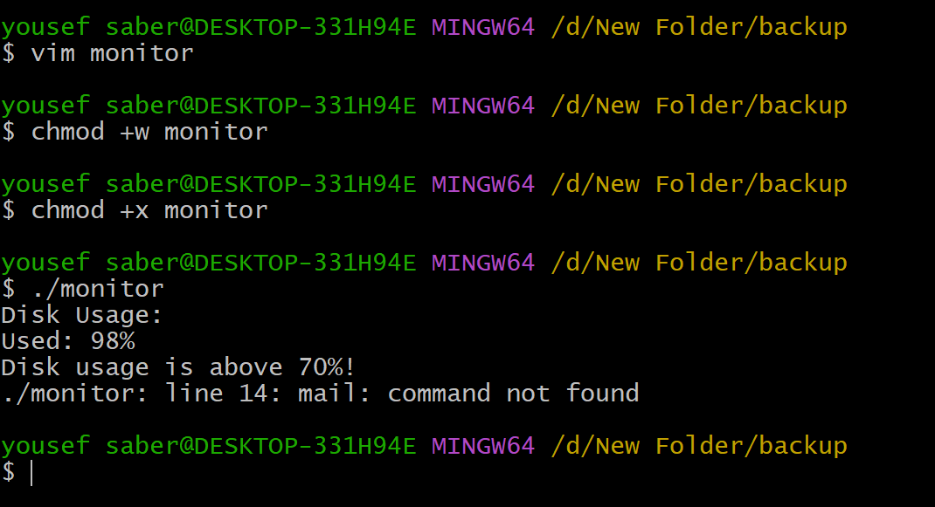
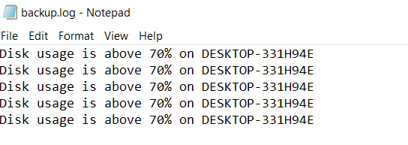
Task 2:Disc monitor

Slide 10
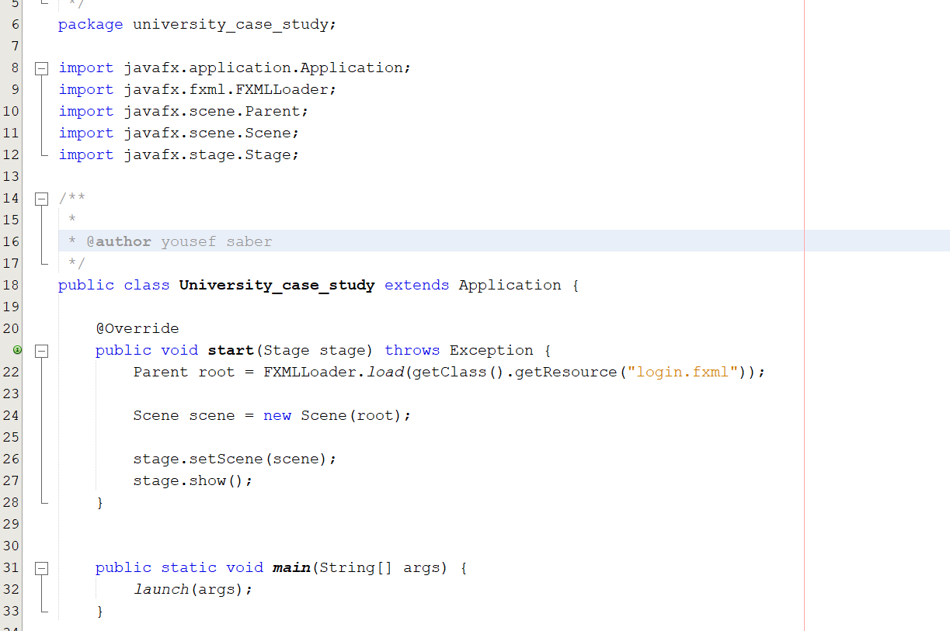
Java application
The Application contain 7 main scenes:
Login scene.
Students’ scene.
Courses scene.
Departments scene.
Instructor scene.
Reporting (GPA) scene.
Enroll scene.
Test scene.
Code Structure:
The code is structured into various methods and functions, each responsible for specific tasks. The main sections include:
• Scenes: Manages all scenes related functionalities.
• Main Controller: Controls the main functionality and GUI switching.
• Database Access Layer: Provides database connectivity and SQL operations.
• Data Transfer: Object (DTO) For Each Entity Showed In the app.
Scenario:
1-Run the from file ((file name). java)

Slide 11
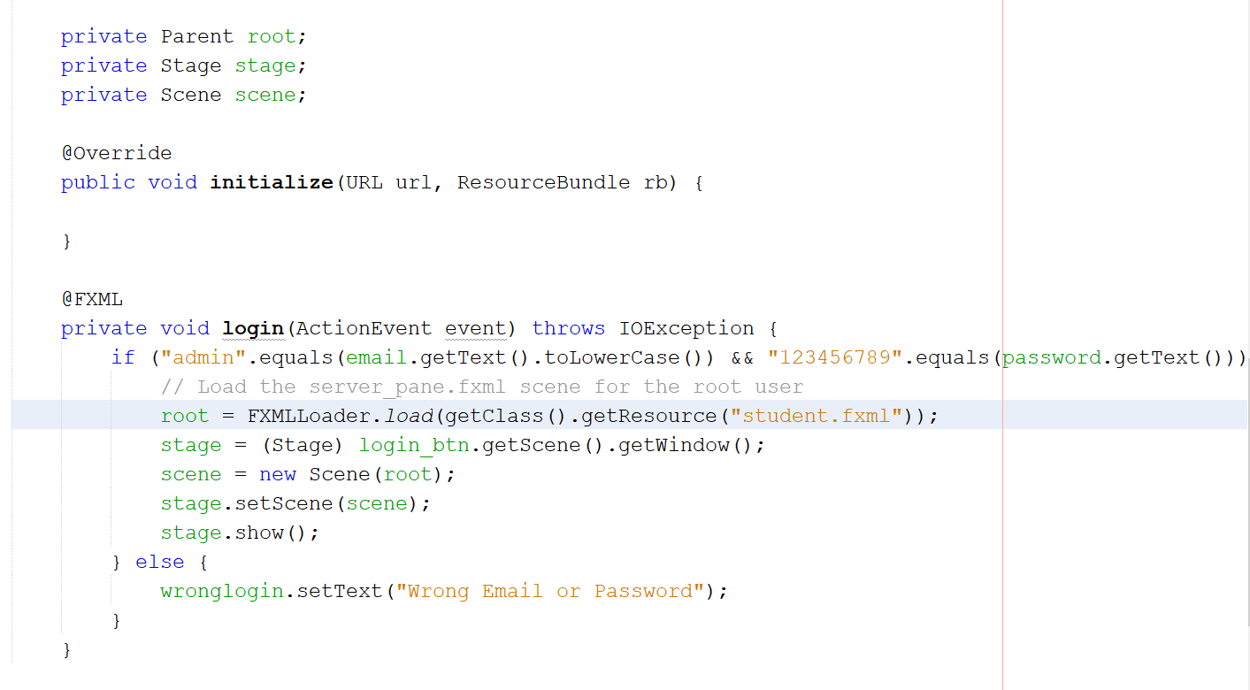

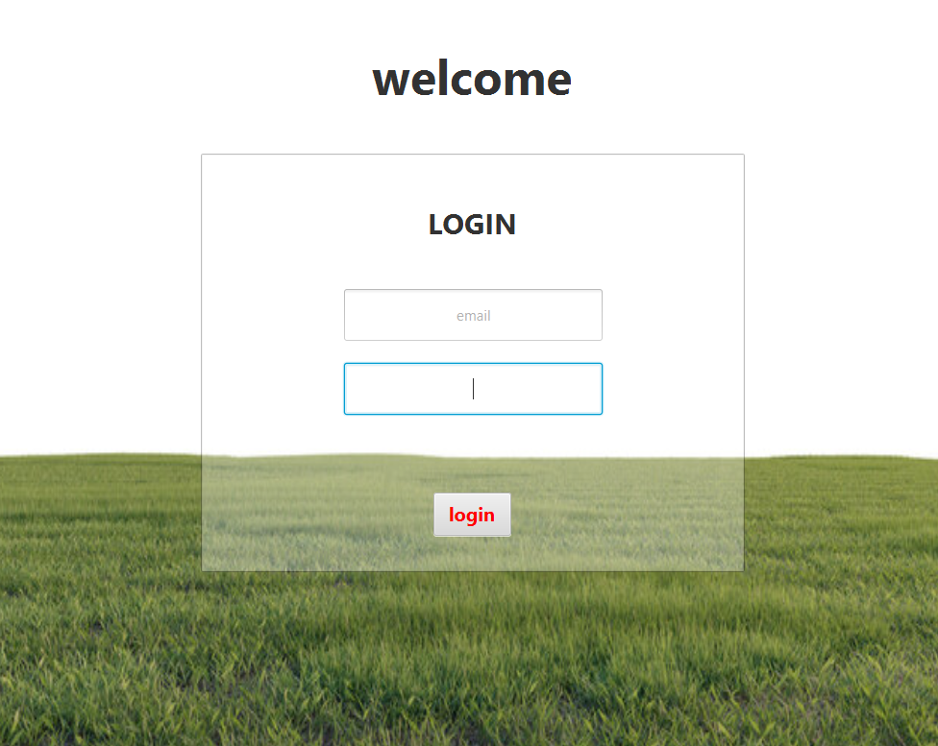
2- It will access the login controller and send you to the login fxml
Login controller some details:
3-From login controller if the email and password is write will transport you to the student fxml scene which have the seven scene we mentioned up:

Slide 12
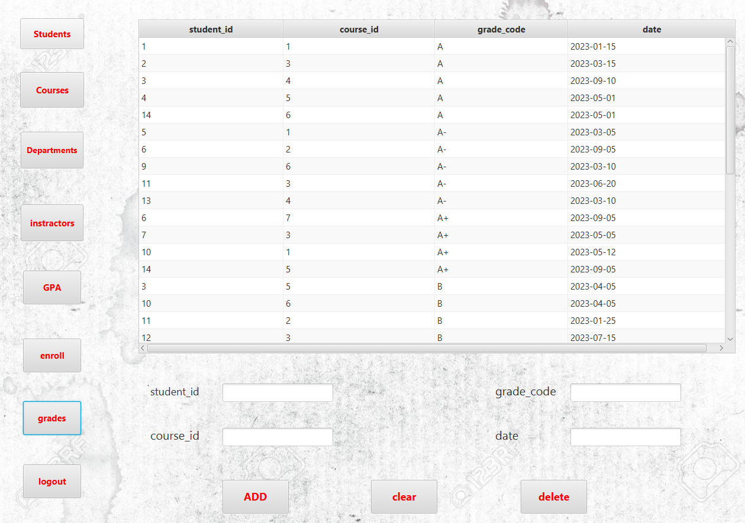
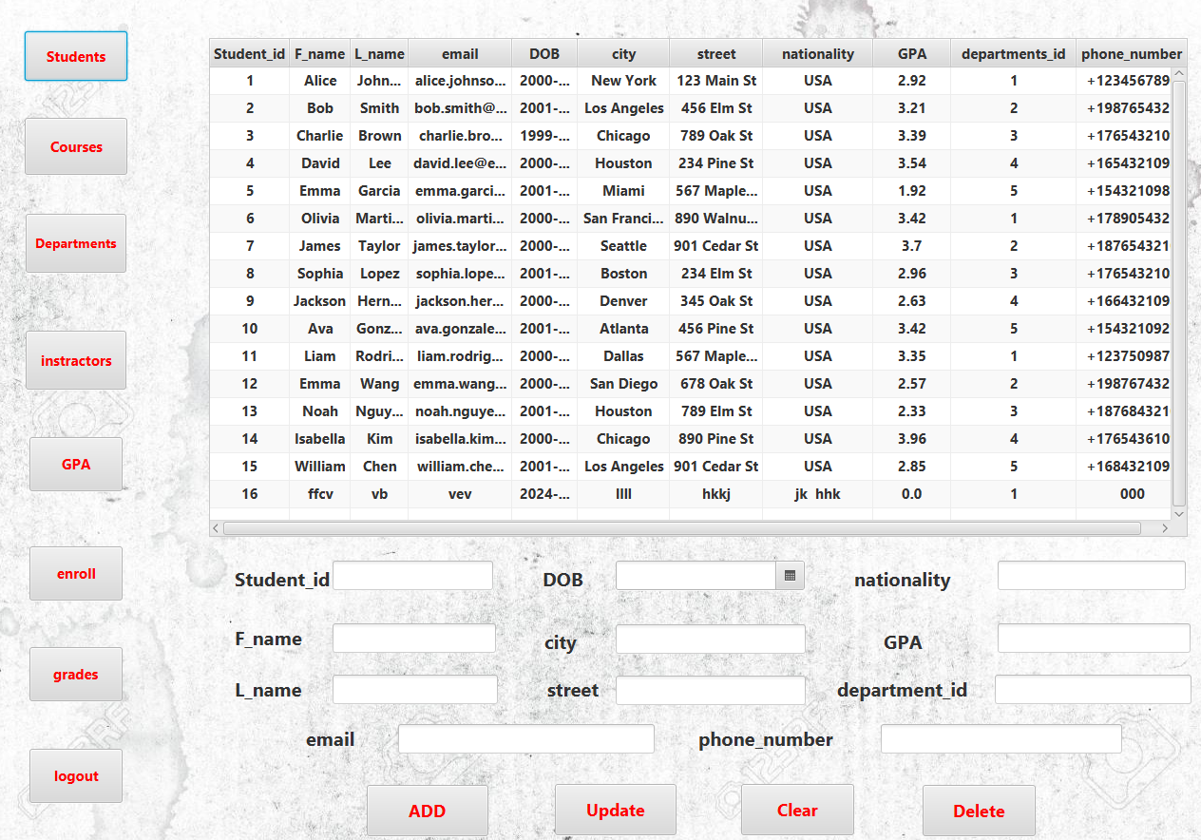
We will describe that button
A.(students-courses-departments-instructors-enroll- grades) have the same thing
1-tables which show the data 2-text filed which we can through it (add-update-delete-clear)
The data and putted in the table.
b. Logout button : make you back again to login scene
c .GPA button (have two tables) describe what is in the photo and this is the report that we do.
---and all that handle in the (student controller) which have around 1500 lines of code to have all things(action , alert, exceptions) in the scene and (DTOS) that I created.

Slide 13
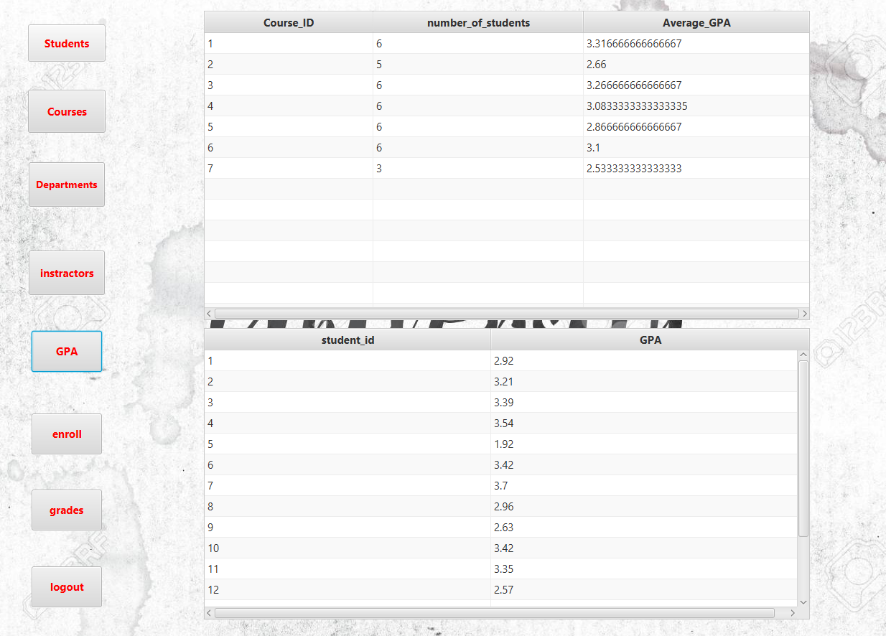
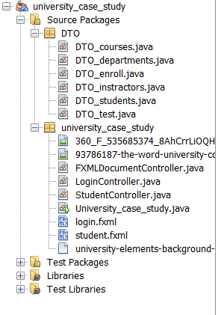
Reporting

Slide 14
Thank you

